Slide 1
Lecture on CFG

Slide 2
Context free Grammar
Context-free grammar is a 4-tuple G = (N, T, P, S) where
T is a finite set of tokens (terminal symbols)
N is a finite set of nonterminals
P is a finite set of productions of the form α → β where α ∈ N and β ∈ (N∪T)*
S ∈ N is a designated start symbol

Slide 3
Example Grammar
Context-free grammar for simple expressions:
G = <{expr,op,digit}, {+,-,*,/,0,1,2,3,4,5,6,7,8,9,),(}, P,expr>
with productions P =
expr→ expr op expr
expr →(expr)
expr → digit
digit → 0 | 1 | 2 | 3 | 4 | 5 | 6 | 7 | 8 | 9
op → + | - | * | /

Slide 4
Notational Conventions Used
Terminals: Lower case letters, operator symbols, punctuation symbols, digits, bolface strings are all terminals
Non Terminals: Upper case letters, lower case italic names are usually non terminals
Greek letters such as α,β,γ represent strings of grammars symbols. Thus a generic production can be written as A→ α

Slide 5
Examples of CFG
Write a CFG that generates Even Palindrome
S → aSa | bSb | є
Write a CFG that generates Odd Palindrome
S → aSa | bSb | a | b
Write a CFG that generates Equal number of a’s and b’s
S → aSbS | bSaS | є

Slide 6
Practice Context Free Grammars
a) CFG generating alternating sequence of 0’s and 1’s
b) CFG in which no consecutive b’s can occur but consecutive a’s can occur
c) CFG for the following language:
L(G)= {a^{n} b^{2n} | n>=0}

Slide 7
Practice Answers
a) S→ 0A | 1B c) S→ aSbb | є
A→ 1B | 1
B→ 0A | 0
S→ aS | bT |a |b
T→ aS | a

Slide 8
Example
Design a CFG for the language
L(G)= {0^{n} 1^{m} | n <> m}
There are two cases:
For n>m
For n<m
Write two separate set of rules and combine them

Slide 9
Example
For n>m
S1→ AB
B→0B1 | Combining both:
A→0A| 0 S → S1 | S2
For n<m
S2→ XY
X→0X1 |
Y→1Y | 1
Є
Є

Slide 10
Practice CFG
Design a CFG for the language
L(G)= {0^{i} 1^{j} 2^{k}| i=j or j=k}
There are two cases:
For i=j
For j=k
Write two separate set of rules and combine them

Slide 11
Solution of Practice
For i=j
S1→ AB
A→0A1 | ε Combining both:
B→2B | ε S → S1 | S2
For j=k
S2→ XY
X→0X | ε
Y→1Y2 | ε

Slide 12
Derivations
The one-step derivation is defined by α A β ⇒ α γ β where A → γ is a production in the grammar
In addition, we define
⇒ is leftmost ⇒_{lm} if α does not contain a nonterminal
⇒ is rightmost ⇒_{rm} if β does not contain a nonterminal
Transitive closure ⇒* (zero or more steps)
Positive closure ⇒⁺ (one or more steps)
The language generated by G is defined by L(G) = {w ∈ T* | S ⇒⁺ w}

Slide 13
Derivation (Example)
Grammar G = ({E}, {+,*,(,),-,id}, P, E) with productions P = E → E + E E → E * E E → ( E ) E → - E E → id
Example derivations:
E ⇒ - E ⇒ - id
E ⇒_{rm} E + E ⇒_{rm} E + id ⇒_{rm} id + id
E ⇒* E
E ⇒* id + id
E ⇒⁺ id * id + id

Slide 14
Example
For the given grammar derive the string
9-5+2 using Left most derivation
Then derive the same string using Right most derivation

Slide 15
Example Grammar
Context-free grammar for simple expressions:
G = <{list,digit}, {+,-,0,1,2,3,4,5,6,7,8,9}, P, list>
with productions P =
list → list + digit
list → list - digit
list → digit
digit → 0 | 1 | 2 | 3 | 4 | 5 | 6 | 7 | 8 | 9

Slide 16
Derivation for the Example Grammar
list ⇒ list + digit ⇒ list - digit + digit ⇒ digit - digit + digit ⇒ 9 - digit + digit ⇒ 9 - 5 + digit ⇒ 9 - 5 + 2
This is an example leftmost derivation, because we replaced the leftmost nonterminal (underlined) in each step. Likewise, a rightmost derivation replaces the rightmost nonterminal in each step

Slide 17
Lecture on Derivations and Ambiguous Grammar

Slide 18
Parse Trees
The root of the tree is labeled by the start symbol
Each leaf of the tree is labeled by a terminal (=token) or ε
Each interior node is labeled by a nonterminal
If A → X₁ X₂ … X_{n} is a production, then node A has immediate children X₁, X₂, …, X_{n} where X_{i} is a (non)terminal or ε (ε denotes the empty string)

Slide 19
Parse Tree for the Example Grammar
Parse tree of the string 9-5+2 using grammar G
list
list
digit
list
digit
digit
The sequence of leafs is called the yield of the parse tree
9
-
5
+
2

Slide 20
Example of Parse Tree
Suppose we have the following grammar
E → E + E
E → E * E
E → ( E )
E → - E
E → id
Perform Left most derivation, right most derivation and construct a parse tree for the string
id+id*id

Slide 21
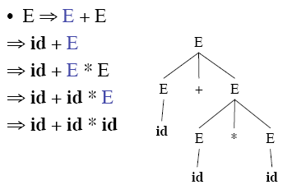
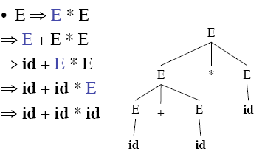
Two possible Parse Trees using Leftmost derivation

Slide 22
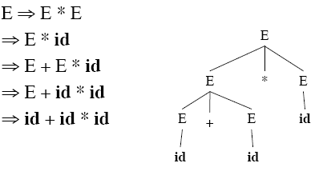
Parse Tree via Right most derivation

Slide 23
Ambiguity
Grammar is ambiguous if more than one parse tree is possible for some string as shown in the previous example. If there are more than one left most derivations or more than one right most derivations.
Ambiguity is not acceptable
Unfortunately, it’s undecidable to check whether a given CFG is ambiguous
Some CFLs are inherently ambiguous (do not have an unambiguous CFG)

Slide 24
Ambiguity (cont’d)
Consider the following context-free grammar:
G = <{string}, {+,-,0,1,2,3,4,5,6,7,8,9}, P, string>
with production P =
string → string + string | string - string | 0 | 1 | … | 9
This grammar is ambiguous, because more than one parse tree represents the string 9-5+2

Slide 25
Two Parse Trees for the same string
string
string
string
string
string
string
string
string
string
string
9
-
5
+
2
9
-
5
+
2

Slide 26
Practice
Show that the following grammar is ambiguous: (Find out strings and two parse trees)
1) S→ AB | aaB 2) S→ a | abSb |aAb
A→ a | Aa A→ bS | aAAb
B→b
3) S→ aSb | SS | ε

Slide 27
Practice
Q1. Show that following languages are not regular:
L= {0^{n}1^{m} 0^{n} : m, n ≥ 0}
Q2. Give context-free grammars that generate following languages.
L= {w ∈ {a, b}∗ : w = w^{rev} and |w| is even}
Q3. Design NFA for the following languages:
L={ w | n_{a} (w) =2 and n_{b} (w)>2 , w Є (a,b)* }
Language over Σ = {a,b} that does not contain aaa as a substring

Slide 28
Practice
Q4. Consider the language F= {a^{i} b^{j} c^{k} | i,j,k >=0 if i=1 then j=k}
Show that F is not regular
Although F acts like a Non Regular language can you give an example where it acts like a Regular Language.
Q5. Write Regular Expressions for the following:
All strings with an even number of b’s
All strings ending in 0’s and containing at least a single 110

